Slide 1
A Survey of Hydra Project
北京大学智能计算与感知实验室
Intelligent Computing and Sensing Laboratory, Peking University
Meng Ma
mameng@pku.edu.cn
Oct. 2012

Slide 2
Outline
Overview of Hydra Project
Hydra Project Objects
Hydra Architecture
Hydra Managers
Use Case of Hydra
Healthcare
Agriculture

Slide 3

Overview of Hydra Project
The HYDRA project develops middleware for networked embedded systems that allows developers to create ambient intelligence applications utilizing device and sensor networks with the help of OSGi Declarative Service and OWL Ontologies.
Source Code: Link Smart 1.1 Modified 2011-11-25
Executable: Link Smart 1.2 Modified 2012-08-28
Series of deliverables documenting the project
Scientific papers

Slide 4
Overview of Hydra Project
HYDRA project overall includes:
Development of a middleware based on a Service-oriented Architecture
Design of a generic semantic model-based architecture supporting model-driven development of applications
Development of a toolkit for developers to develop applications on the middleware
Design of a business modeling framework for analyzing the sustainability of applications
Distributed security and privacy
Network Support and Device Management
Ontology-based knowledge modeling

Slide 5
Overview of Hydra Project
Developing Environment:
A series of development tools are available: The Hydra Software Development Kit (SDK), Device Development Kit (DDK) and IDE (Integrated Development Environment.
Integration with Visual Studio/Eclipse to support application developers with ”template projects”.
Pre-made development projects, quick start
Developers Guide and Tutorials

Slide 6
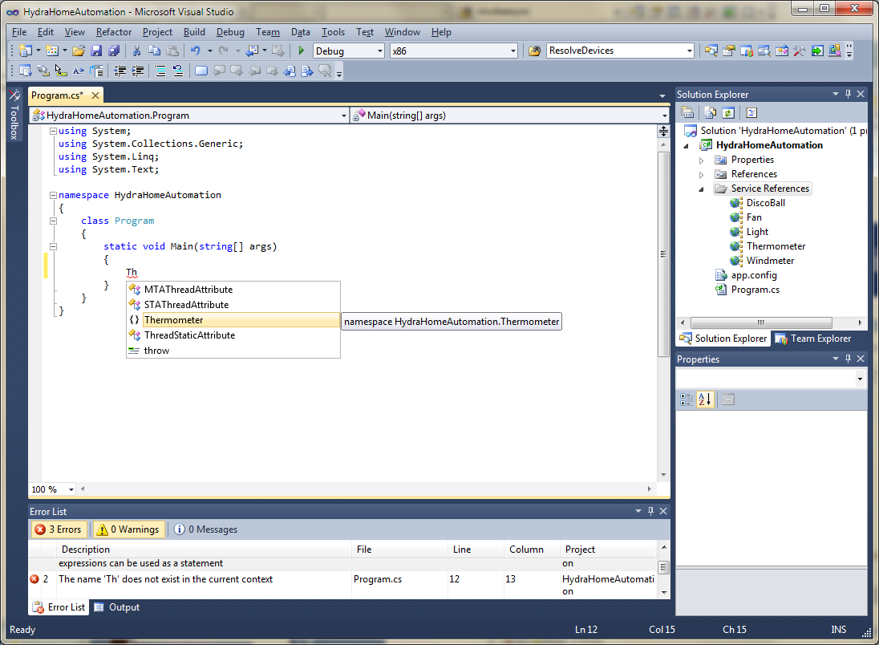
Device object in application
Notes:
6

Slide 7
Overview of Hydra Project
Discovery Architecture
Ontology-driven device discovery
P2P architecture for Device Networks
Accessing and controlling devices irrespective of where they are
Secure Service access
Secure Communication between core managers
Policy Manager integrated to configure/control access to devices
Storage Manager
Save and logging data
Context Manager
Allows to set up rules for applications
“When door opens, turn on light”
“When no one home, shut down stand-by devices”
Notes:
7

Slide 8
Hydra-enabled Devices
Bloodpressure Monitor: UA-767 BPM, A&D Medical
Weightscale: BT Weightscale, A&D Medical
Bloodpressure Monitor, Siemens
GlucoseMeter, SmartGenie
DLNA Media Renderer: Noxon, TerraTec
DLNA Media Renderer: Streamium SL 400i, Philips
DLNA Media Renderer: AV Renderer, Intel
DLNA Media Server: AV Server, Intel
Zigbee Coordinator, Labor S.r.L
Zigbee Transceiver, MaxStream
Zigbee Temperature Sensor Sensirion (SHT11)
Zigbee Pressure Sensor VTI (SCP 1000D01)
Zigbee Accelerometer, ST Microelectronics
Wireless Thermometer, Heavyweather
Wireless Windmeter, HeavyWeather
Wireless Rainsensor, HeavyWeather
Wireless Airpressure, HeavyWeather
Mobile Phone, Sony Ericsson, Z600
Smartphone, HTC
SmartPhone/GPS Device, HTC
RF-power switch, Nexa (Disccoball, Fan. Light, Train)
RF-power dimmer-switch, Nexa
Navigator, Nuvi 610, Garmin
WebCam, Axis 206
Router, D624, D-Link
SunSpot Thermometer, IEEE 802.15.4
SunSpot Accelerometer, IEEE 802.15.4
RFIDSec, Sigma, RFID Tag.
Phidget Sensors- movement, light, vibration
LonWorks switches
Z-Wave Sensors
ePlasters patch
VarioPort
WII Balance Board
PlugWise Smart Plugs
Ploggs Smart Plugs
Lego Mindstorms
AMIS multi level counter, Siemens
AMIS load switching device, Siemens
Notes:
8

Slide 9
Overview of Hydra Project
The HYDRA middleware addresses two different types of users:
Developer users, who will use the Hydra middleware to develop their applications,
End-users, who will use Hydra applications developed by the developer users.

Slide 10
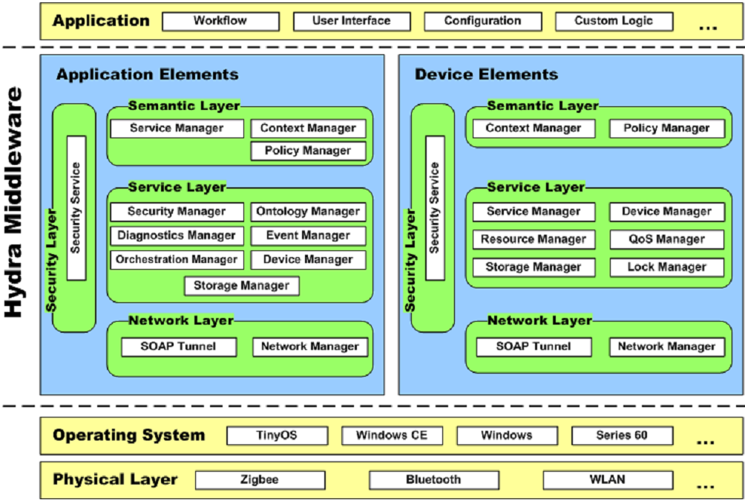
Hydra/LinkSmart (Eisenhauer, M@SECON’09)

Slide 11
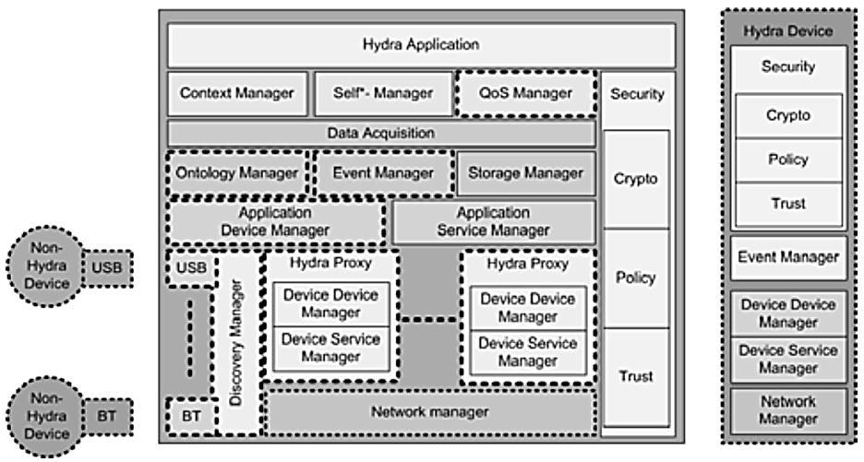
Hydra Architecture

Slide 12
Hydra
In Hydra, the overall functional architecture is divided into two parts, namely:
Application Elements(AEs) : AEs are meant to be deployed and run on comparably powerful machines.
Device Elements(DEs) : DEs describe components that are usually deployed inside Hydra-enabled devices where small devices may be involved.

Slide 13
Hydra Managers
Network Manager: which handles the lower networking issues as part of the network layer
Context Manager: for the definition of conditions triggering an alert.
Event Manager: for creating events based on measured data
Device Manager: which offers the possibility of finding devices that support different network protocols
Ontology Manager: which permits one to describe devices on a semantic level
Diagnostics Manager: which is used to monitor the system’s conditions, error detection and logging

Slide 14
Hydra Managers
Secuirty: Hydra incorporates in its design high-level security, trust and privacy concerns.
QoS Manager: QoS Manager is a service component that applies a semantic service selection algorithm to support the decision for selecting best-suitable service.

Slide 15
Ontology Managers
Reasoner: The reasoner module is responsible for reasoning about devices and their status and provides inferencing mechanisms for instance to conclude what type of device has entered the network.
Query module: The query module allows for retrieving information regarding devices and their capabilities.
Update module: The update module allows entering of new information, deletion and changes to the ontology at both design time and run time.
Versioning: The versioning module is responsible for managing different version of the ontology. This includes different versions of devices and services.
Parse & Annotate: The parse & annotate modules is responsible for automatically update the ontology with new device types.

Slide 16
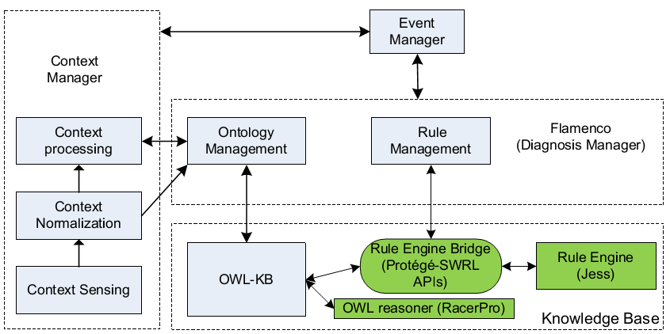
Context/Event Manager

Slide 17
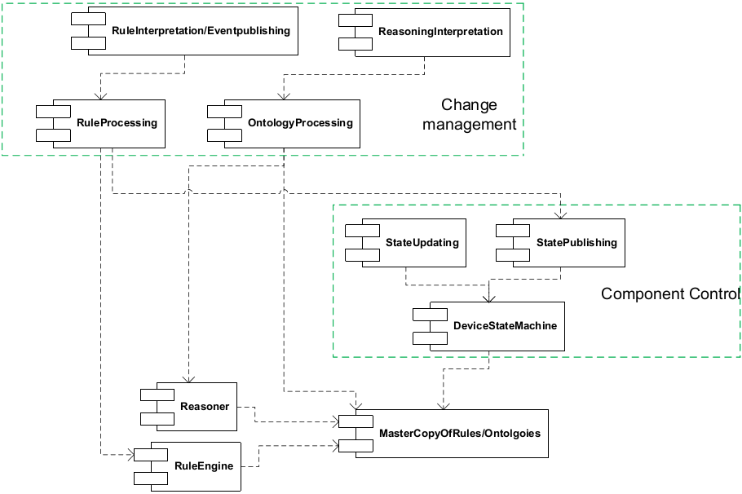
Diagnostics Managers
Rule/Ontology Processing
State Processing

Slide 18
Use Case of Hydra
The implemented HYDRA middleware and toolkit is validated in real end-user scenarios in three different user domains:
a) Facility management (home automation)
b) Healthcare
c) Agriculture

Slide 19
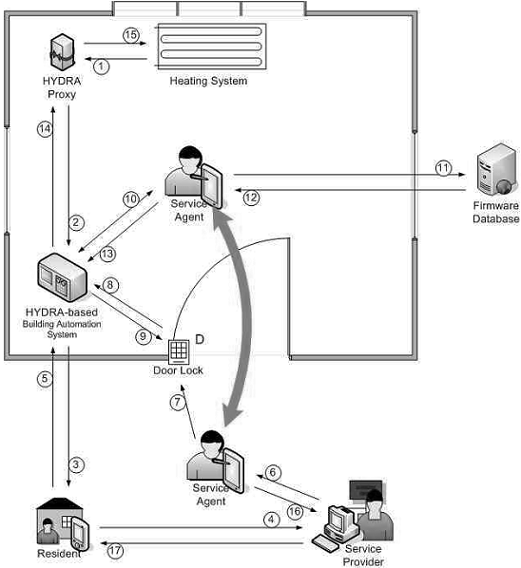
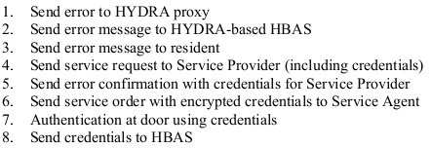
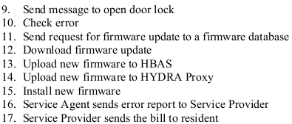
Use Case: Building Automation

Slide 20
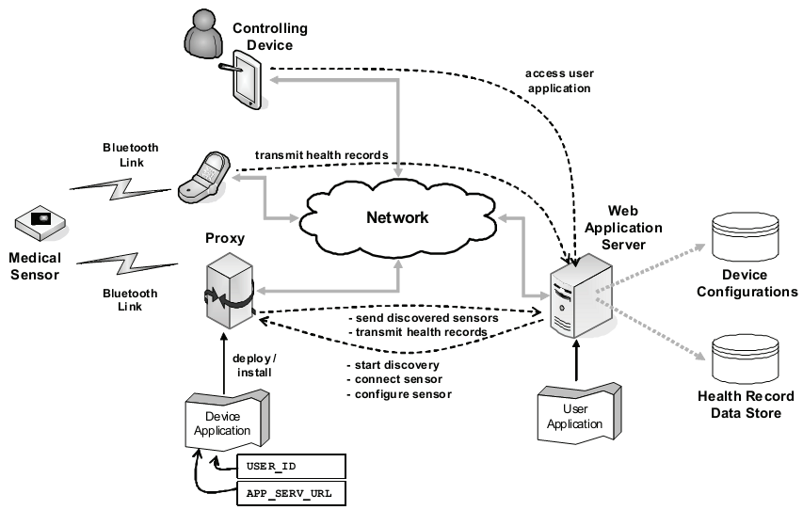
Use Case: Healthcare

Slide 21
Thank You.

